Slide 1


SINGLETON PATTERN

Slide 2
CONTENTS…
1. What is singleton pattern?
2. Singleton class structure
3. Types of singleton pattern
4. Benefits and drawbacks

Slide 3
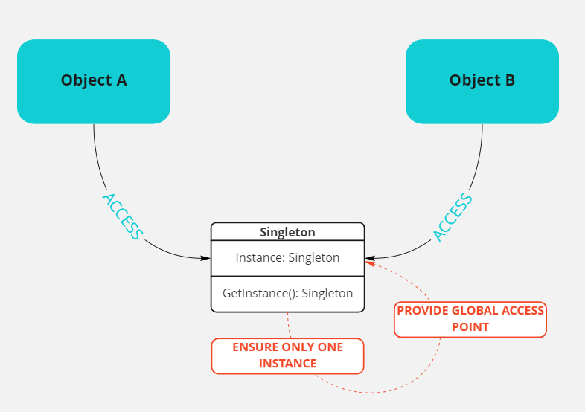
What is singleton pattern?
Allows only a single instance of a class itself to be created.
The purpose of the singleton design pattern is to ensure that a class only has one instance and provide a global point of access to it throughout the life of an application.
In other words, it ensures that single instance of a class is created and shared among all other objects in an application.

Slide 4
Singleton Class Structure
A class should have the following structure for singleton pattern:
1) Should have a private or protected constructor. No public and parameterized constructors.
2) Should have a static property (with a private backing field) to return an instance of a class. A static method can also be used to return an instance.
3) At least have one non-static public method for a singleton operation.

Slide 5
Types of Singleton Pattern
No Thread Safe Singleton
Thread-Safe Singleton
Thread Safety Singleton using Double-Check Locking

Slide 6
A) Non Thread Safe Singleton
In non-thread safe singleton type, two different threads could both have evaluated the test (if instance == null) and found it to be true, then both create instances, which violates the singleton pattern.
Whenever two concurrent threads determine that the condition (if instance == null) to true, they both construct instances of the class which violates the singleton framework pattern.

Slide 7
B) Thread-Safe Singleton
In this type, the thread is considered as a lock mechanism on a shared object and determines whether an instance has been created or not. It takes care of the memory barrier issue and ensures that only one thread will create an instance. For example: Since only one thread can be in that part of the code at a time, by the time the second thread enters it, the first thread will have created the instance, so the expression will evaluate as false.
The biggest problem with this is performance; performance suffers since a lock is required every time an instance is requested.

Slide 8

C) Thread Safety Singleton using Double-Check Locking
Thread safety singleton using double-check locking is a design pattern in C# used to create a singleton object that can be accessed by multiple threads simultaneously without causing any data corruption or race conditions.
In this design pattern, the singleton instance is created lazily when it is first requested. Double-check locking is used to ensure that the singleton instance is only created once, and that it is thread-safe.
Involves checking whether the singleton instance has been created before acquiring a lock. If the instance has not been created, the lock is acquired, and another check is performed to ensure that the instance has not been created by another thread while waiting for the lock. If the instance has not been created, it is created within the lock, and the lock is released.

Slide 9
Benefits
Provides a single point of access: The Singleton pattern ensures that only one instance of a class exists in the system and provides a single point of access to that instance.
Ensures global access to a shared resource: By ensuring that only one instance of a class exists, the Singleton pattern can be used to provide global access to a shared resource.
Reduces memory consumption: By limiting the number of instances of a class that can exist, the Singleton pattern can help reduce memory consumption in a system.
Improves performance: Since the Singleton pattern ensures that only one instance of a class is created, it can help improve the performance of an application by reducing the number of object creations and method invocations.

Slide 10
Drawbacks
Can introduce global state: By providing global access to a shared resource, the Singleton pattern can introduce global state into an application, which can make it more difficult to test and maintain.
Can be difficult to unit test: Because the Singleton pattern ensures that only one instance of a class exists, it can be difficult to unit test components that depend on that class.
Can make code harder to understand: Since the Singleton pattern introduces a layer of complexity into an application, it can make the code harder to understand and maintain.
Can introduce thread safety issues: If not implemented properly, the Singleton pattern can introduce thread safety issues, such as race conditions, deadlocks, and data corruption.

